Slide 1
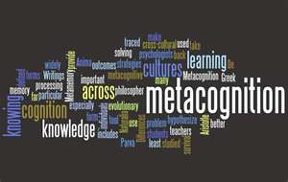
Metacognition: The Key to Changing Mindsets and Closing the Achievement Gap
Saundra Yancy McGuire, Ph.D.
Retired Asst. Vice Chancellor & Professor of Chemistry
Director Emerita, Center for Academic Success
Louisiana State University

Slide 2
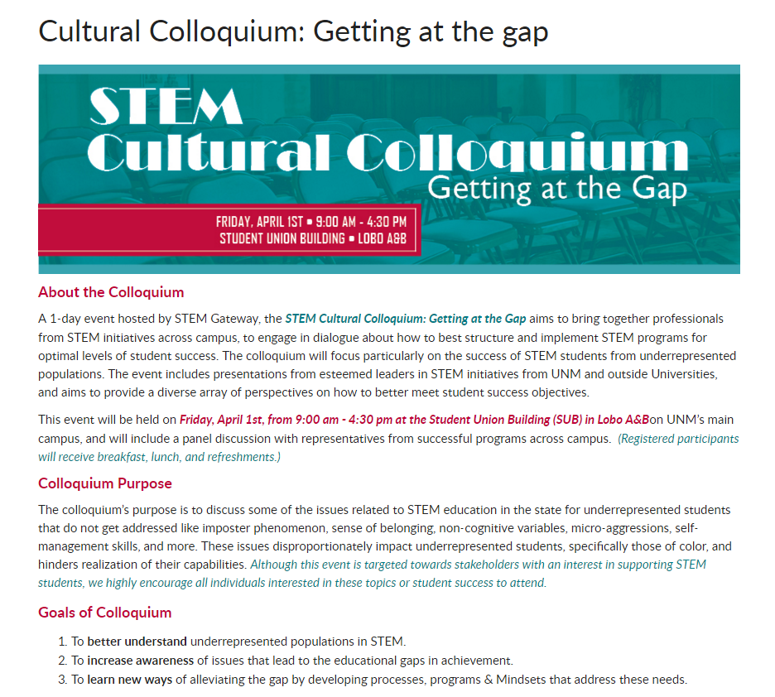

Slide 3
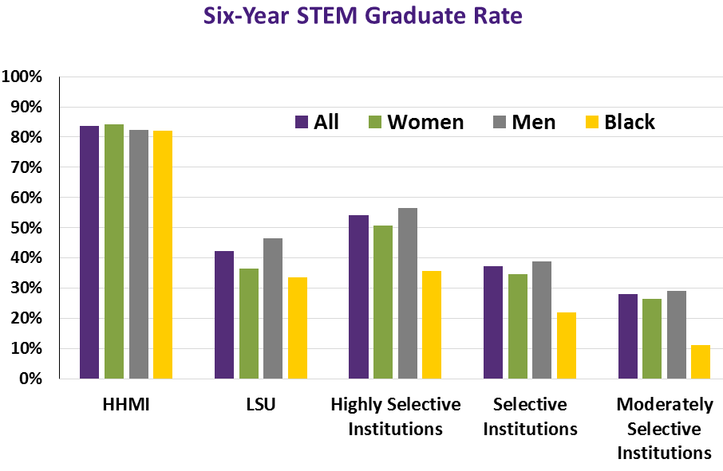


LSU-HHMI Professors Program
84% STEM Graduation Rate
  84% women
  83% men
  82% African-American

Slide 4
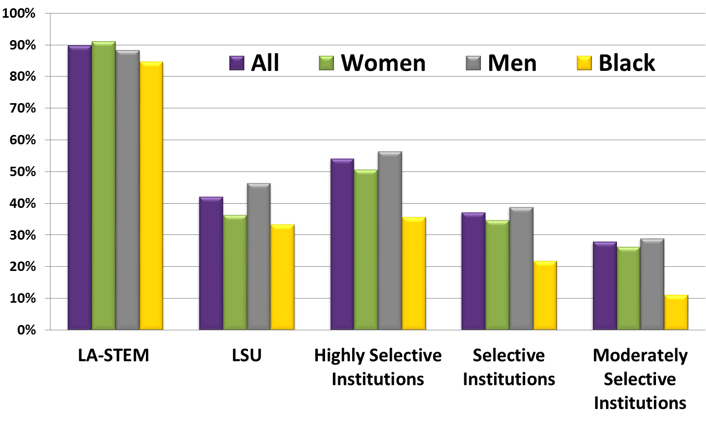
LA-STEM Program Outcomes
249 Scholars served since 2003
(with the 1st cohort in 2008)
146 LA-STEM Graduates (through May 2015)
42% graduated with a min. 3.7 cum G.P.A. (through May 2015)
  52% women graduates
  31% minority graduates
78% have completed or are pursuing post-baccalaureate programs
Six-Year STEM Graduate Rate
90% Overall STEM Graduation Rate
Data from the 2014-2015 STEM Retention Report prepared by the Center of Institutional Data Exchange and Analysis at the University of Oklahoma. LA-STEM Graduation Rate includes all applicable scholars accepted into the program and graduates through May 2015.

Slide 5


Elements of LSU HHMI/LA-STEM Programs
Improved Study and Note Taking Skills
Enhanced Metacognitive skills
Development of Group Interaction Skills
Improved Time Management Skills
Enhanced Science Comprehension Through Research
Development of Mentoring Skills
Notes:
44% of all scholars served are underrepresented minorities, and we have had a fairly equal distribution of male and female participants.
Most of our scholars have come from the College of Science followed by Engineering. We are seeing a growing number of students in the College of Agriculture.

Slide 6
Metacognition
The ability to:
think about your own thinking
be consciously aware of yourself as a problem solver
monitor, plan, and control your mental processing (e.g. “Am I understanding this material, or just memorizing it?”)
accurately judge your level of learning
Know what you know and what you don’t know
Flavell, J. H. (1976). Metacognitive aspects of problem solving. In L. B. Resnick (Ed.), The nature of intelligence (pp.231-236). Hillsdale, NJ: Erlbaum

Slide 7


Slide 8
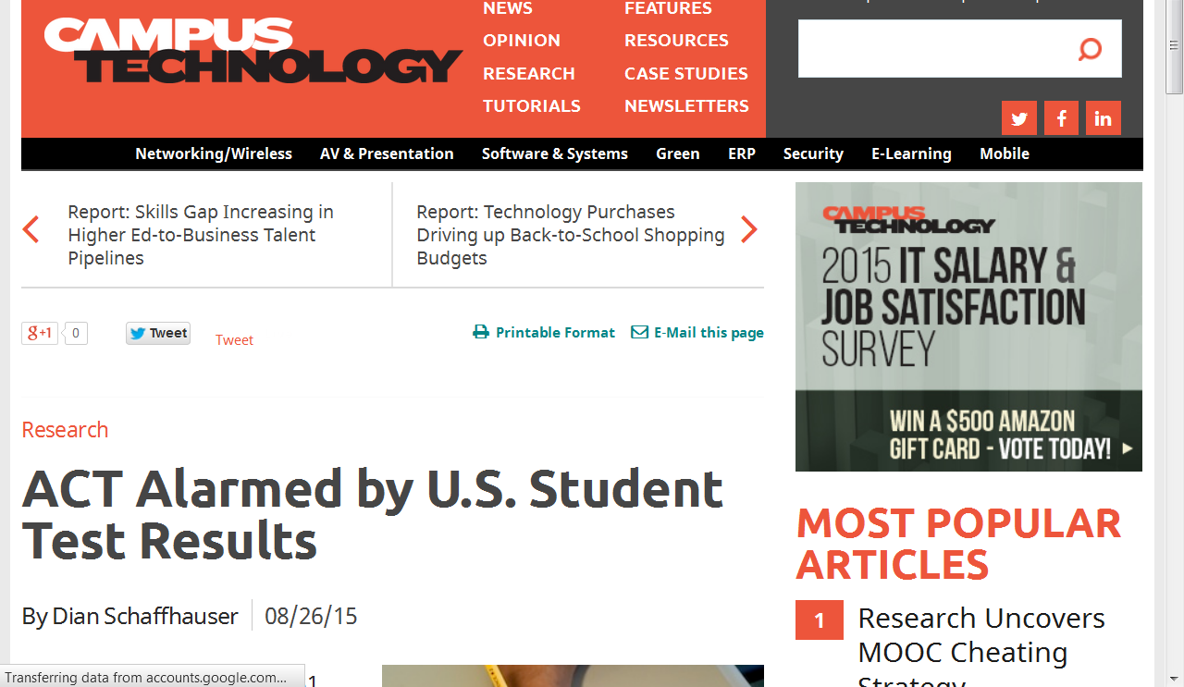
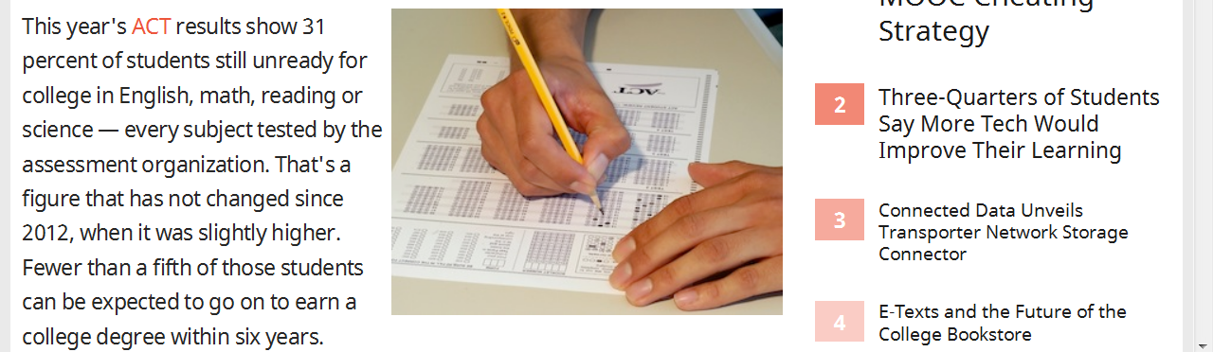

Slide 9
What did most of your teachers in high school do the day before the test?
How do you think most students would answer the following?
What did they do during this activity?
What grade would you have made on the test if you had gone to class only
on the day before the test?

Slide 10

Faculty and Staff Must Help Students
Make the Transition to the University
Help students identify and close “the gap”
current behavior current grades
productive behavior desired grades

Slide 11
Reflection Questions
What’s the difference, if any, between studying and learning?
For which task would you work harder?
A. Make an A on the test
B. Teach the material to the class

Slide 12
The Story of Two Students
Travis, junior psychology student
47, 52, 82, 86 B in course
Dana, first year physics student
80, 54, 91, 97, 90 (final) A in course

Slide 13
A Reading Strategy that Works: SQ3R (4R or 5R)
Survey (look at intro, summary, bold print, italicized words, etc.)
Question (devise questions survey that you think the reading will answer)
Read (one paragraph at a time)
Recite (summarize in your own words)
Record or wRite (annotate in margins)
Review (summarize the information in your words)
Reflect (other views, remaining questions)

Slide 14
Travis, junior psychology student
47, 52, 82, 86
Problem: Reading Comprehension
Solution: Preview text before reading*
Develop questions*
Read one paragraph at a time
and paraphrase information
* Developing an anticipatory set

Slide 15
First Voyage of Christopher Columbus
WITH HOCKED GEMS FINANCING HIM/ OUR HERO BRAVELY DEFIED ALL SCORNFUL LAUGHTER/ THAT TRIED TO PREVENT HIS SCHEME/ YOUR EYES DECEIVE/ HE HAD SAID/ AN EGG/ NOT A TABLE/ CORRECTLY TYPIFIES THIS UNEXPLORED PLANET/ NOW THREE STURDY SISTERS SOUGHT PROOF/ FORGING ALONG SOMETIMES THROUGH CALM VASTNESS/ YET MORE OFTEN OVER TURBULENT PEAKS AND VALLEYS/ DAYS BECAME WEEKS/ AS MANY DOUBTERS SPREAD FEARFUL RUMORS ABOUT THE EDGE/ AT LAST/ FROM NOWHERE/ WELCOME WINGED CREATURES APPEARED/ SIGNIFYING MOMENTOUS SUCCESS
Dooling, J.D. and Lachman, R. Effects of Comprehension on Retention of Prose, Journal of Experimental Psychology, (1971), Vol. 88, No. 2, 216-222

Slide 16
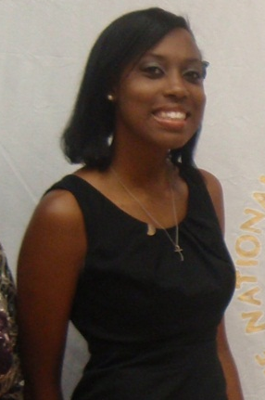
Dana, first year physics student
80, 54, 91, 97, 90 (final)
Problem: Memorizing formulas and using on-line solutions help for problems
Solution: Solve problems with no external aids and test mastery of concepts

Slide 17
Problem Solving is Essential to Student Success!
Homework system that can be taught
Study information before looking at the problems/questions
Work example problems (without looking at the solutions) until you get to the answer
Check to see if answer is correct
If answer is not correct, figure out where mistake was made, without consulting solution
Work homework problems/answer questions as if taking a test

Slide 18



Why the Fast and Dramatic Increase?
It’s all about the strategies, and getting them to engage their brains!

Slide 19
Counting Vowels in 45 seconds
How accurate are you?
Count the vowels
in the words on the next slide.

Slide 20
Dollar Bill
Dice
Tricycle
Four-leaf Clover
Hand
Six-Pack
Seven-Up
Octopus
Cat Lives
Bowling Pins
Football Team
Dozen Eggs
Unlucky Friday
Valentine’s Day
Quarter Hour

Slide 21
How many words or phrases from the list do you remember?

Slide 22
Let’s look at the words again…
What are they arranged
according to?

Slide 23
Dollar Bill
Dice
Tricycle
Four-leaf Clover
Hand
Six-Pack
Seven-Up
Octopus
Cat Lives
Bowling Pins
Football Team
Dozen Eggs
Unlucky Friday
Valentine’s Day
Quarter Hour

Slide 24
NOW, how many words or phrases from the list do you remember?

Slide 25
What were two major differences between the 1st and 2nd attempts?

Slide 26
1. We knew what the task was
2. We knew how the information
was organized

Slide 27

An Excellent Introduction
Bransford, J.D., Brown, A.L., Cocking, R.R. (Eds.), 2000. How people learn:
Brain, Mind, Experience, and School. Washington, DC: National Academy Press.

Slide 28
What we know about learning
Active learning is more lasting than passive learning
-- Passive learning is an oxymoron*
Thinking about thinking is important
  Metacognition**
The level at which learning occurs is important
  Bloom’s Taxonomy***
  *Cross, Patricia, “Opening Windows on Learning” League for Innovation in the Community College, June 1998, p. 21.
** Flavell, John, “Metacognition and cognitive monitoring: A new area of cognitive–developmental inquiry.” American Psychologist, Vol 34(10), Oct 1979, 906-911.
*** Bloom Benjamin. S. (1956). Taxonomy of Educational Objectives, Handbook I: The Cognitive Domain. New York: David McKay Co Inc.

Slide 29
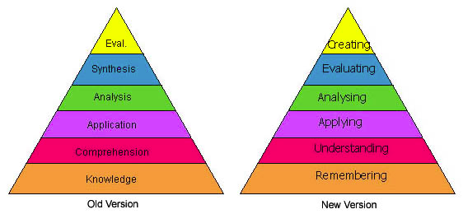
Bloom’s Taxonomy
Anderson & Krathwohl, 2001
http://projects.coe.uga.edu/epltt/index.php?title=Bloom's_Taxonomy

Slide 30
This pyramid depicts the different levels of thinking we use when learning. Notice how each level builds on the foundation that precedes it. It is required that we learn the lower levels before we can effectively use the skills above.
Bloom’s Taxonomy
Creating
Putting elements together to form a coherent or functional whole; reorganizing elements into a new pattern or structure through generating,
planning, or producing.
Making judgments based on criteria and standards through checking and critiquing.
Evaluating
Breaking material into constituent parts, determining how the parts relate to one another and to an overall structure .
Analyzing
Carrying out or using a procedure through executing, or implementing.
Applying
Constructing meaning from oral, written, and graphic messages through interpreting, exemplifying, classifying, summarizing, inferring, comparing, and explaining.
Understanding
Retrieving, recognizing, and recalling relevant knowledge from
long-term memory.
Remembering
http://www.odu.edu/educ/llschult/blooms_taxonomy.htm

Slide 31

When we teach students about Bloom’s Taxonomy…
They GET it!

Slide 32
How do you think students answered?
At what level of Bloom’s did you have to operate to make A’s or B’s in high school?
Remembering
Understanding
Applying
Analyzing
Evaluating
Creating

Slide 33
How students answered (2008)
At what level of Bloom’s did you have to operate to make A’s or B’s in high school?
Remembering
Understanding
Applying
Analyzing
Evaluating
Creating

Slide 34

At what level of Bloom’s did you have to operate to make A’s or B’s in high school?
How students answered (2013)
Remembering
Understanding
Applying
Analyzing
Evaluating
Creating

Slide 35
At what level of Bloom’s did you have to operate to make A’s and B’s in high school?
How students answered (2014)
Remembering
Understanding
Applying
Analyzing
Evaluating
Creating

Slide 36
At what level of Bloom’s did you have to operate to make A’s and B’s in high school?
How students answered (2015)
Remembering
Understanding
Applying
Analyzing
Evaluating
Creating
1

Slide 37
How do you think students answered?
At what level of Bloom’s do you think you’ll need to operate to make A’s in college courses?
Remembering
Understanding
Applying
Analyzing
Evaluating
Creating

Slide 38
How students answered (in 2008)
At what level of Bloom’s do you think you’ll need to operate to make an A’s in college?
Remembering
Understanding
Applying
Analyzing
Evaluating
Creating

Slide 39
How students answered (in 2013)
At what level of Bloom’s do you think you’ll need to operate to make A’s in college?
Remembering
Understanding
Applying
Analyzing
Evaluating
Creating

Slide 40
At what level of Bloom’s do you think you’ll need to operate to make A’s in college?
How students answered (in 2014)
Remembering
Understanding
Applying
Analyzing
Evaluating
Creating

Slide 41
At what level of Bloom’s do you think you’ll need to operate to make A’s in college?
How students answered (in 2015)
Remembering
Understanding
Applying
Analyzing
Evaluating
Creating

Slide 42
How do we teach students to move higher on Bloom’s Taxonomy?
Teach them the Study Cycle*
*adapted from Frank Christ’s PLRS system

Slide 43

The Study Cycle
4
Reflect
3
Review
4
Reflect
Preview
Preview before class – Skim the chapter, note headings and boldface words, review summaries and chapter objectives, and come up with questions you’d like the lecture to answer for you.
Attend
Attend class – GO TO CLASS! Answer and ask questions and take meaningful notes.
Review
Review after class – As soon after class as possible, read notes, fill in gaps and note any questions.
Study
Study – Repetition is the key. Ask questions such as ‘why’, ‘how’, and ‘what if’.
Intense Study Sessions* - 3-5 short study sessions per day
Weekend Review – Read notes and material from the week to make connections
Assess
Assess your Learning – Periodically perform reality checks
Am I using study methods that are effective?
Do I understand the material enough to teach it to others?
Intense Study Sessions
1 | Set a Goal | 1-2 min | Decide what you want to accomplish in your study session
2 | Study with Focus | 30-50 min | Interact with material- organize, concept map, summarize, process, re-read, fill-in notes, reflect, etc.
3 | Reward Yourself | 10-15 min | Take a break– call a friend, play a short game, get a snack
4 | Review | 5 min | Go over what you just studied
Center for Academic Success
B-31 Coates Hall ▪ 225.578.2872 ▪www.cas.lsu.edu

Slide 44
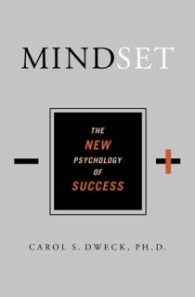

Help Students Develop the Right Mindset
Shenk, David, 2010. The Genius in All of Us: Why Everything You've Been Told About Genetics, Talent, and IQ Is Wrong. New York: Doubleday
Dweck, Carol, 2006.
Mindset: The New Psychology
of Success. New York:
Random House Publishing

Slide 45
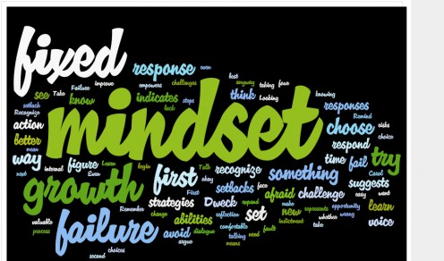
Mindset* is Important!
Fixed Intelligence Mindset
Intelligence is static
You have a certain amount of it
Growth Intelligence Mindset
Intelligence can be developed
You can grow it with actions
Dweck, Carol (2006) Mindset: The New Psychology of Success.
New York: Random House Publishing

Slide 46
Responses to Many Situations are Based on Mindset
 | Fixed Intelligence Mindset Response | Growth Intelligence Mindset Response
Challenges | Avoid | Embrace
Obstacles | Give up easily | Persist
Tasks requiring effort | Fruitless to Try | Path to mastery
Criticism | Ignore it | Learn from it
Success of Others | Threatening | Inspirational

Slide 47
Email from a Spring 2011 General Chemistry Student
“…Personally, I am not so good at chemistry and unfortunately, at this point my grade for that class is reflecting exactly that. I am emailing you inquiring about a possibility of you tutoring me.”
April 6, 2011
-------------------------------------------------------------------------------------------------------------------------------
“I made a 68, 50, (50), 87, 87, and a 97 on my final.
I ended up earning a 90 (A) in the course, but I started with a 60 (D). I think what I did different was make sidenotes in each chapter and as I progressed onto the next chapter I was able to refer to these notes. I would say that in chemistry everything builds from the previous topic.
May 13, 2011
  Semester GPA: 3.8

Slide 48
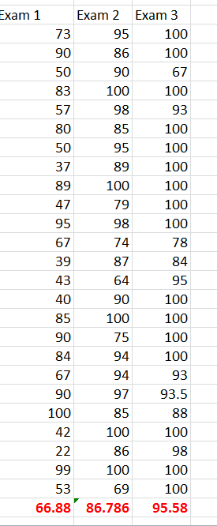
Mr. Lorenzo Foster’s Physics I AP Class Test Scores
Teaching Metacognitive Strategies Appears to Have Made an Impact!
Lorenzo Foster’s Physics I AP Class Test Scores

Slide 49
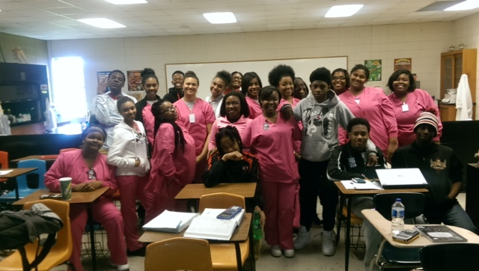
Physics I AP Students
After Learning Their Test 2 Scores

Slide 50
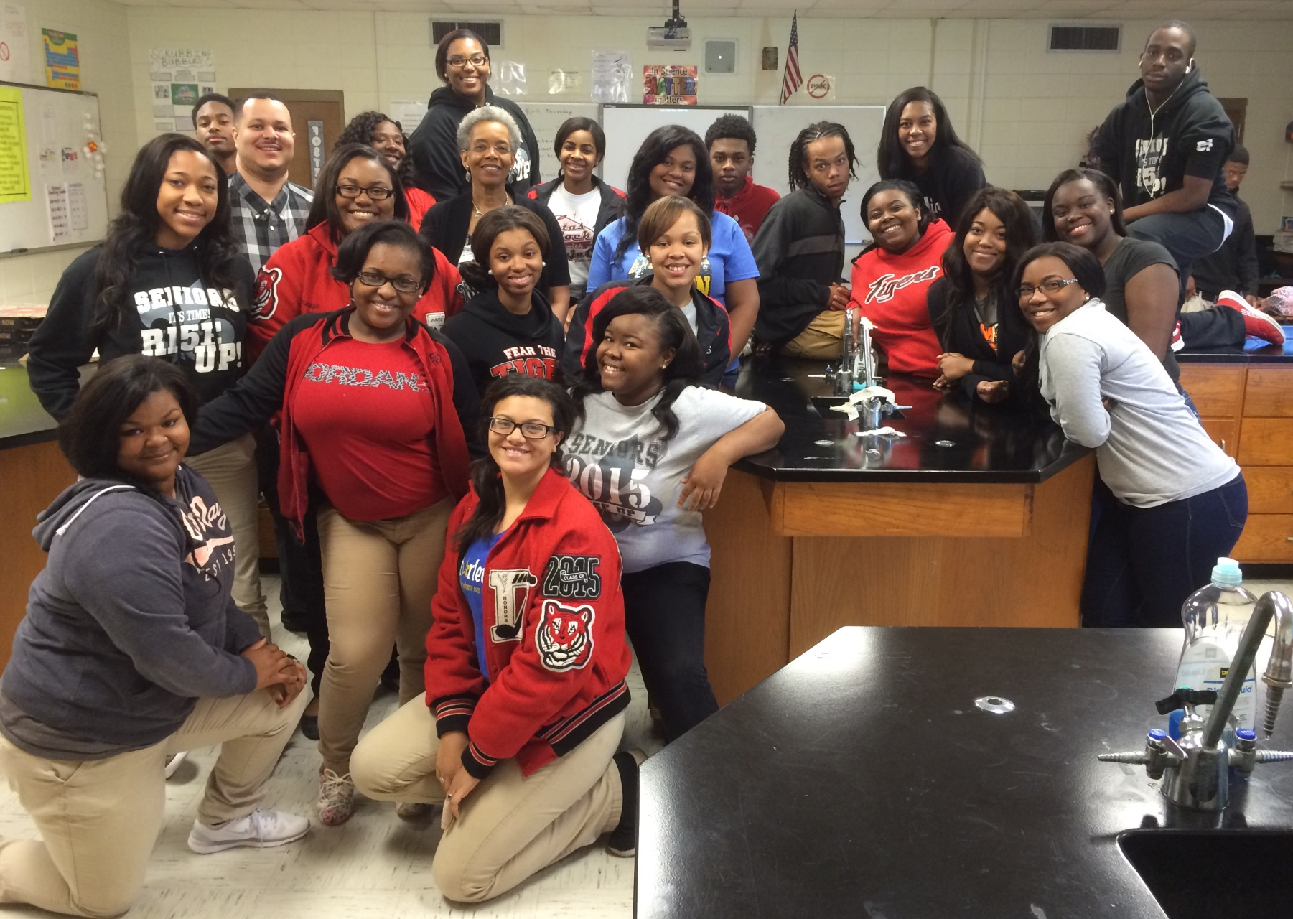
Physics I AP Students
After Learning Their Test 3 Scores

Slide 51
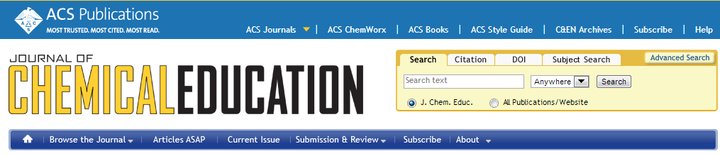
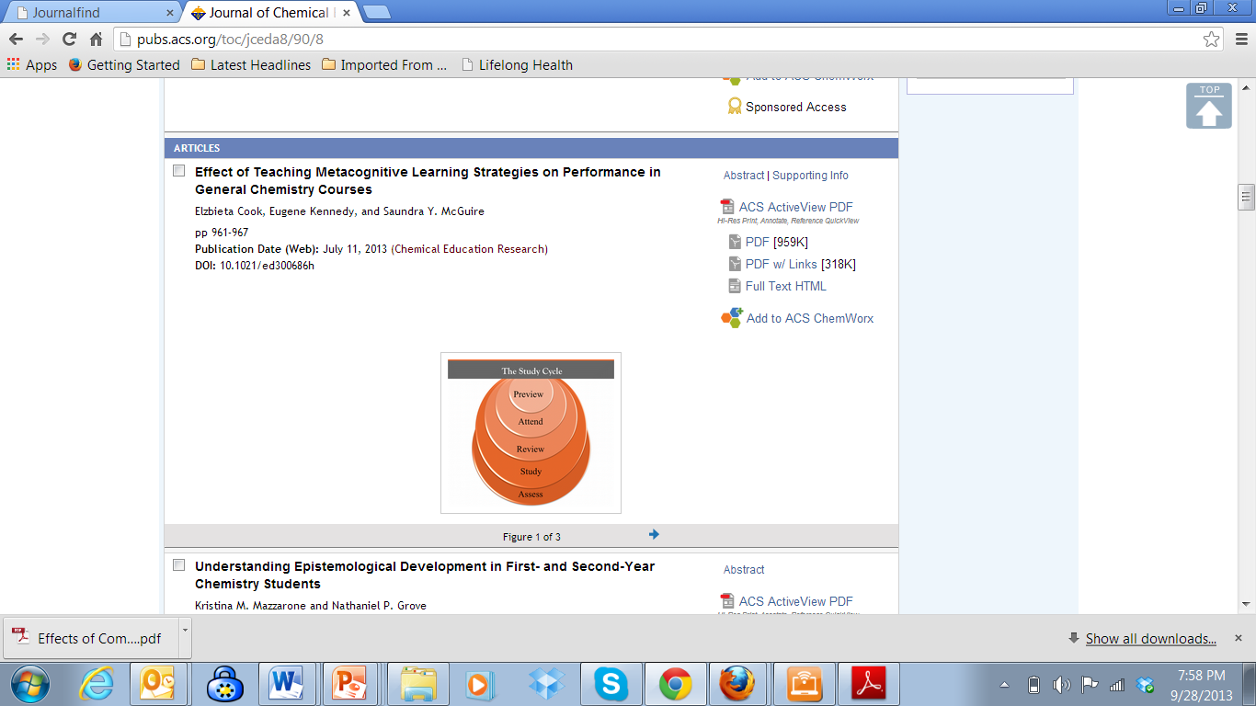
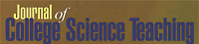
Metacognition: An Effective Tool to Promote Success
in College Science Learning*
Ningfeng Zhao¹, Jeffrey Wardeska¹, Saundra McGuire², Elzbieta Cook²
¹Department of Chemistry, East Tennessee State University
²Department of Chemistry, Louisiana State University
*March/April 2014 issue of JCST, Vol. 43, No. 4, pages 48-54

Slide 52
Sharing Strategies that Have Worked for Others Can Be Very Motivational

Slide 53
Before and After
Robert, freshman chemistry student
42, 100, 100, 100 A in course
Michael, senior pre-med organic student
30, 28, 80, 91 B in course
Miriam, freshman calculus student
37.5, 83, 93 B in course
Ifeanyi, sophomore thermodynamics student
67, 54, 68, 95 B in course
Terrence, junior Bio Engineering student
GPA 1.67 cum, 3.54 (F 03), 3.8 (S 04)
Meaningful Learning Rote Learning

Slide 54
Top 5 Reasons Students Did Poorly on Test 1 in General Chemistry
1. Didn’t spend enough time on the material
2. Started the homework too late
3. Didn’t memorize the information I needed to memorize
4. Did not use the book
5. Assumed I understood information that I had read and re-read, but had not applied

Slide 55
Top 5 Reasons Students Made an A on Test 1:
1. Did preview-review for every class
2. Did a little of the homework at a time
3. Used the book and did the suggested problems
4. Made flashcards of the information to be memorized
5. Practiced explaining the information to others

Slide 56
Email from ENG Professor at New Mexico State Univ.
Received on 10/22/2013
At the end of a 60 minute learning strategies presentation by the professor, students were given a survey to determine their self-assessment of whether they were using or not using the strategies. The average scores of the different groups on the first two exams are shown below.
Self-Reported Use of Strategies | Exam 1 | Exam 2
Did not use the strategies | 58 | 54
Used metacognitive strategies | 95 | 80

Slide 57
Comments from Engineering Students about what they changed for Test 3*
I changed my study habits by doing the homework early. I also started reading some of the material before going to the class. The most effective was spending more time on the material.
I started studying for the exam sooner. I also took more time to do the homework. I reviewed/rewrote my notes from class.
I studied for the class as close to everyday as possible
I got together with other classmates and helped them with their weakness and of course they helped me with mine as well.
*class average increased from 65.7% to 80.5%!
(for students who took all three course exams)

Slide 58
LSU Analytical Chemistry Graduate Student’s Cumulative Exam Record
2004 – 2005
9/04 Failed
10/04 Failed
11/04 Failed
12/04 Failed
1/05 Passed
2/05 Failed
3/05 Failed
4/05 Failed
2005 – 2006
10/05 Passed
11/05 Failed
12/05 Passed best in group
1/06 Passed
2/06 Passed
3/06 Failed
4/06 Passed last one!
5/06 N/A
Began work with CAS and the Writing Center in October 2005

Slide 59

Dr. Algernon Kelley, December 2009

Slide 60
Knowledge of Metacognition Greatly Increases URM Student Success
They are less likely to have been cognitively challenged in high school
They are more likely to feel that they don’t belong*
They are more likely to think that initial failure means they are not “smart” enough and become victims of stereotype threat*
They are more likely to feel that the other students and the professor do not respect them*
*Aguilar, L., Walton, G., Wieman, C.. Physics Today 67(5), 43 (2014); doi: 10.1063/PT.3.2383

Slide 61
From a Xavier University student to Dr. Kelley in Fall 2011
Oct. 17, 2011
Hello Dr. Kelley. … I am struggling at Xavier and I REALLY want to succeed, but everything I've tried seems to end with a "decent" grade. I’m not the type of person that settles for decent. What you preached during the time you were in Dr. Privett's class last week is still ringing in my head. I really want to know how you were able to do really well even despite your circumstances growing up. I was hoping you could mentor me and guide me down the path that will help me realize my true potential while here at Xavier. Honestly I want to do what you did, but I seriously can't find a way how to. Can I please set up a meeting with you as soon as you’re available so I can learn how to get a handle grades and classes?
Oct. 24, 2011
Hey Dr. Kelley, I made an 84 on my chemistry exam (compared to the 56 on my first one) using your method for 2 days (without prior intense studying). Thanks for pointing me in the right direction. I’ll come by your office Friday and talk to you about the test.
Nov 3, 2011
Hey Dr. Kelley! I have increased my Bio exam grade from a 76% to a 91.5% using your system. Ever since I started your study cycle program, my grades have significantly improved. I have honestly gained a sense of hope and confidence here at Xavier. My family and I are really grateful that you have taken time to get me back on track.

Slide 62
We can significantly change mindsets and close the achievement gap!
We must teach students the learning process, provide specific strategies and motivate students to use the strategies
We must not judge student potential on initial performance
We must encourage students to persist in the face of initial failure
We must encourage the use of metacognitive tools

Slide 63
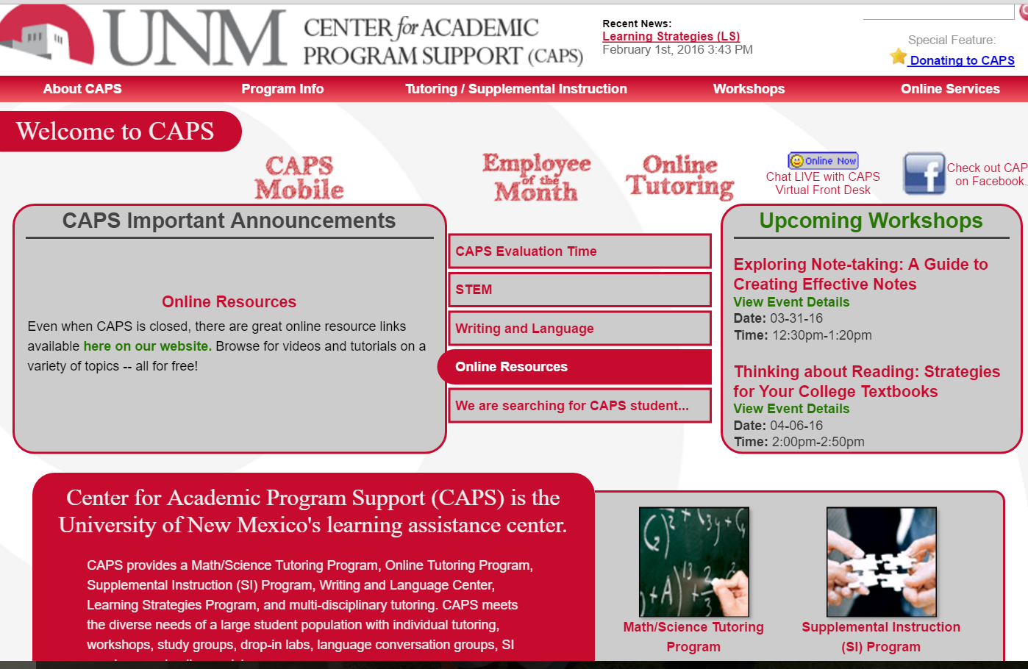
An Awesome Partner
2012 NCLCA/LSCHE Website Award Winner – Honorable Mention

Slide 64
Useful Websites
www.caps.unm.edu
www.cas.lsu.edu
www.howtostudy.org
www.vark-learn.com
www.drearlbloch.com
Searches on www.google.com

Slide 65
Additional References
Bruer, John T. , 2000. Schools For Thought: A Science of Learning in the Classroom. MIT Press.
Bransford, J.D., Brown, A.L., Cocking, R.R. (Eds.), 2000. How people learn: Brain, Mind, Experience, and School. Washington, DC: National Academy Press.
Cromley, Jennifer, 2000. Learning to Think, Learning to Learn: What the Science of Thinking and Learning Has to Offer Adult Education. Washington, DC: National Institute for Literacy.
Ellis, David, 2006. Becoming a Master Student.* Boston: Cengage Learning.
Hoffman, Roald and Saundra Y. McGuire. (2010). Learning and Teaching Strategies. American Scientist , vol. 98, pp. 378-382.
Nilson, Linda, 2004. Teaching at Its Best: A Research-Based Resource for College Instructors. Bolton, MA: Anker Publishing Company.
Pierce, William, 2004. Metacognition: Study Strategies, Monitoring, and Motivation.
http://academic.pg.cc.md.us/~wpeirce/MCCCTR/metacognition.htm
*Excellent student reference

Slide 66
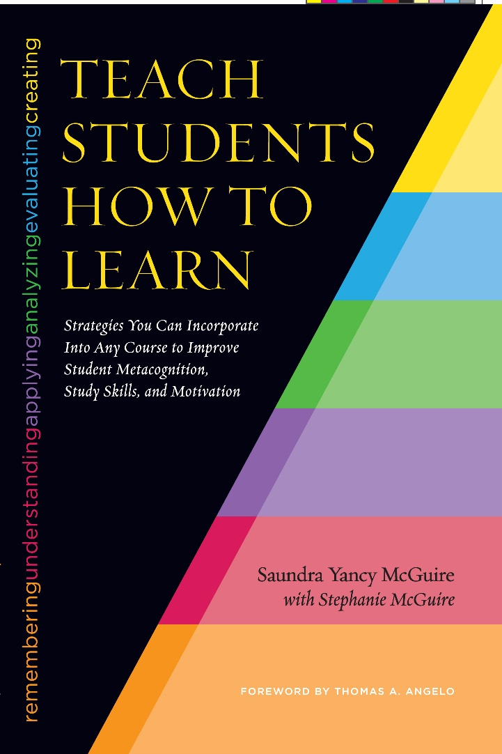
A New Reference
McGuire, S.Y. (2015). Teach Students How to Learn: Strategies You Can Incorporate into Any Course to Improve Student Metacognition, Study Skills, and Motivation. Sterling, VA: Stylus

